Slide 1
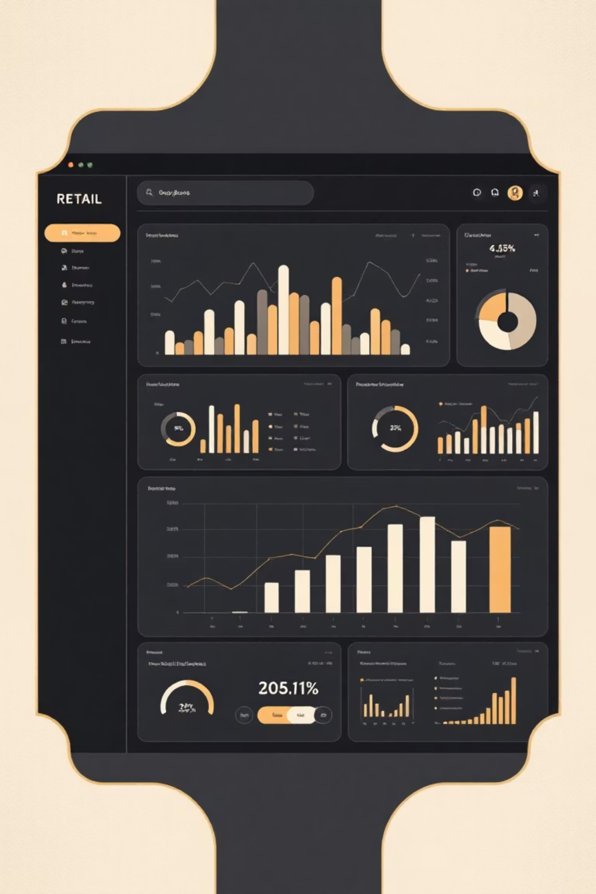
Customer Shopping Behavior Analysis
Uncovering insights from 3,900 purchases to drive strategic business decisions

Slide 2
Dataset Overview
3,900
18
37
Total Purchases
Data Points
Missing Values
Transactions analyzed across multiple categories
Features covering demographics and behavior
Only in Review Rating column
Customer Data
Transaction Details
Age, Gender, Location
Product, Category, Amount
Subscription Status
Discounts & Promotions
Purchase History
Shipping & Ratings

Slide 3
Data Preparation Journey
01
02
03
Data Loading
Exploration
Cleaning
Imported dataset using pandas for analysis
Structure check and summary statistics
Imputed missing ratings using category medians
04
05
Feature Engineering
Database Integration
Created age groups and purchase frequency metrics
Loaded cleaned data into PostgreSQL

Slide 4


Revenue by Gender
Analysis reveals spending patterns across gender segments, providing insights for targeted marketing strategies.
Total revenue comparison
Average purchase amounts
Category preferences by gender

Slide 5


Discount & Spending Insights
High-Value Discount Users
Top-Rated Products
Shipping Preferences
5 products with highest average review ratings
Standard vs Express purchase amount comparison
Customers using discounts while spending above average

Slide 6


Subscription Impact
Subscribers vs Non-Subscribers
Repeat Buyer Analysis
Key differences in spending behavior:
Customers with 5+ purchases show higher subscription rates
Average spend per transaction
Total revenue contribution
Purchase frequency patterns

Slide 7
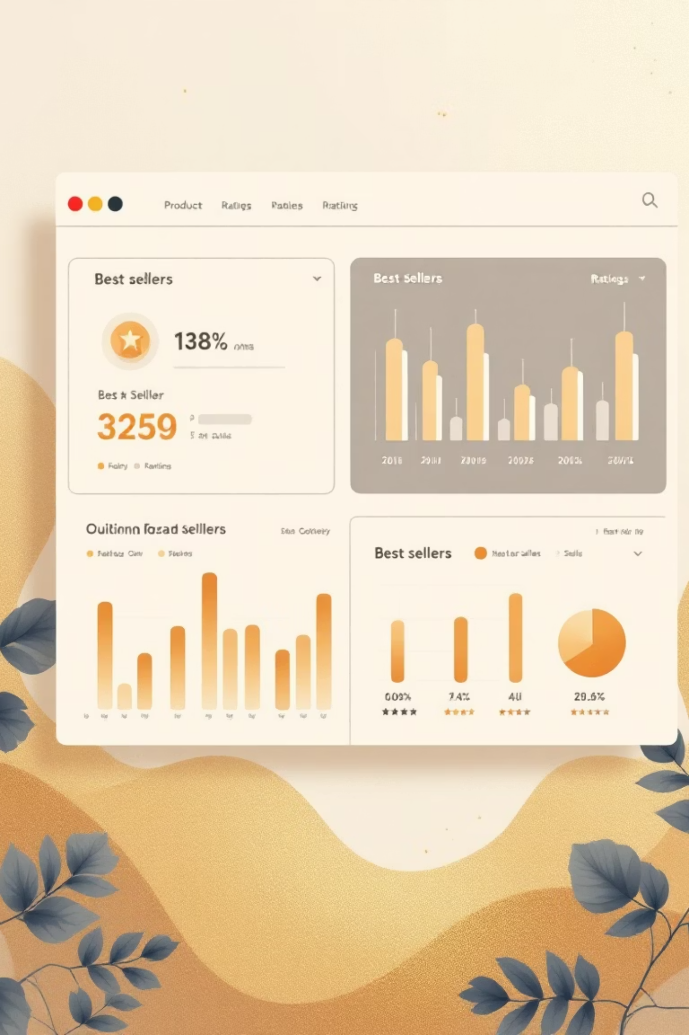
Product Performance
1
2
Discount-Dependent Products
Top Products per Category
5 products with highest percentage of discounted purchases
Most purchased items within each product category
3
Customer Favorites
Highest-rated products driving satisfaction

Slide 8



Customer Segmentation
Returning
2-5 purchases showing engagement
New Customers
First-time buyers exploring products
Loyal
5+ purchases, highest lifetime value

Slide 9
Revenue by Age Group
35%
28%
25-34 Age Group
35-44 Age Group
Highest revenue contribution
Strong purchasing power
22%
15%
18-24 Age Group
45+ Age Group
Growing segment potential
Steady loyal customers

Slide 10





Strategic Recommendations
Boost Subscriptions
Promote exclusive benefits for subscribers
Loyalty Programs
Reward repeat buyers to increase retention
Review Discount Policy
Balance sales growth with margin control
Targeted Marketing
Focus on high-revenue age groups and express shipping users

